Slide 1
Spotify Tracks Dataset
Data Visualization and Visual Analytics
0816137 HW #3+4.

Slide 2
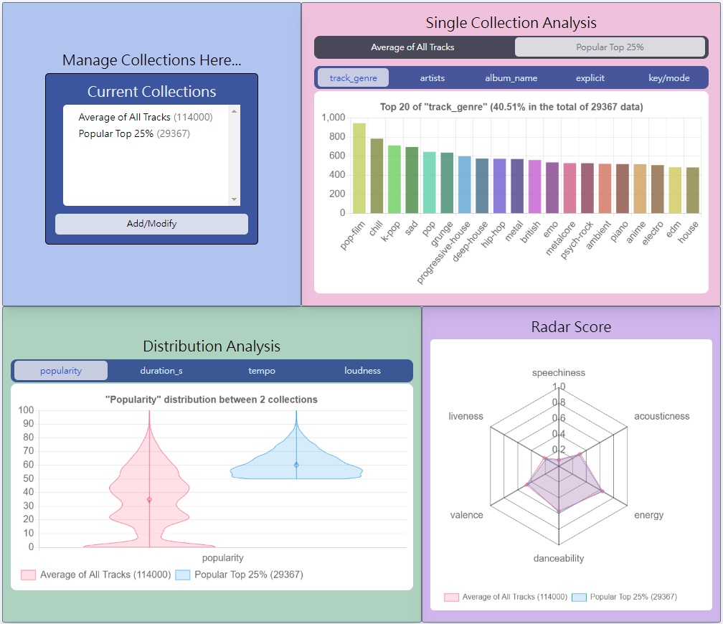
General Picture
Definition of ”collection” :
A set of tracks
This is a general analysis tool – SpotiTracks,
built for analyzing Spotify tracks.
Users can create custom collections, and
compare between them easily.
This feature introduces a wide flexibility
of how a user can dig information from
the dataset.

Slide 3
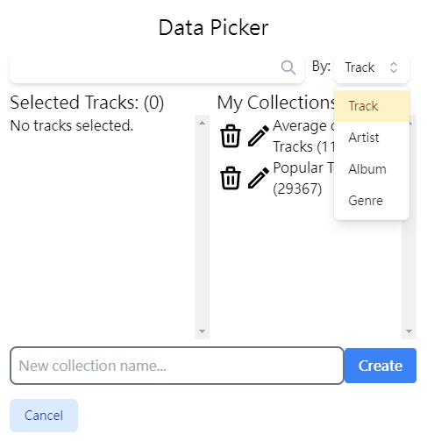
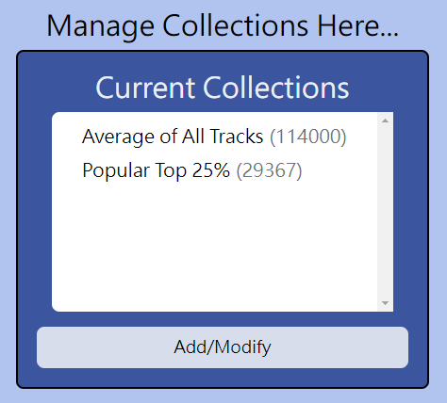
How to Use It…
Search tracks by track/artist/album/genre (Fuzzy search implemented)
Selected tracks will appear here
Name your custom set
of tracks and click “create”
to add to collections
Click button opens modal
Users are able to add/modify
his own set of tracks for analysis

Slide 4
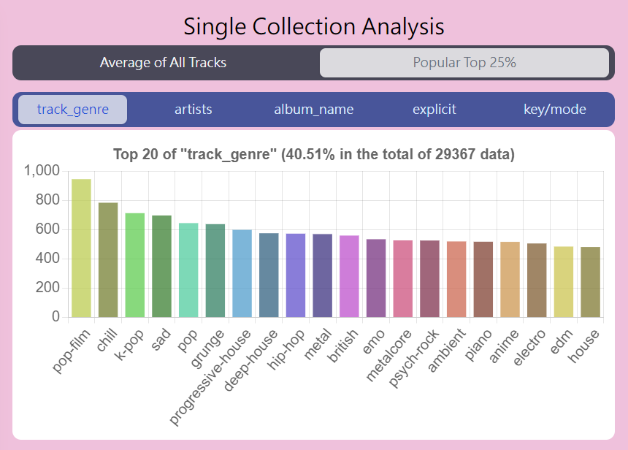
How to Use It…
Choose the collection to analyze
Discrete aspects in the collection
It can’t fit all the types on the graph,
hence shows only 20 types at most.
The pink graph analyzes the
discrete aspects of selected collection

Slide 5
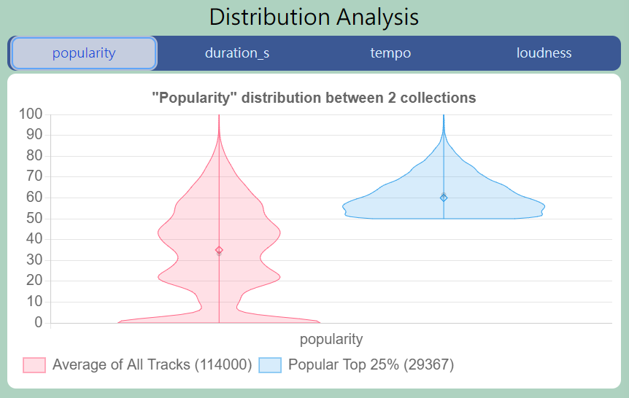
How to Use It…
Continuous aspects in the collection
Violin plot for each collection
The green graph analyzes the
distribution of continuous data between each collection
Toggle (on/off) to hide a collection

Slide 6
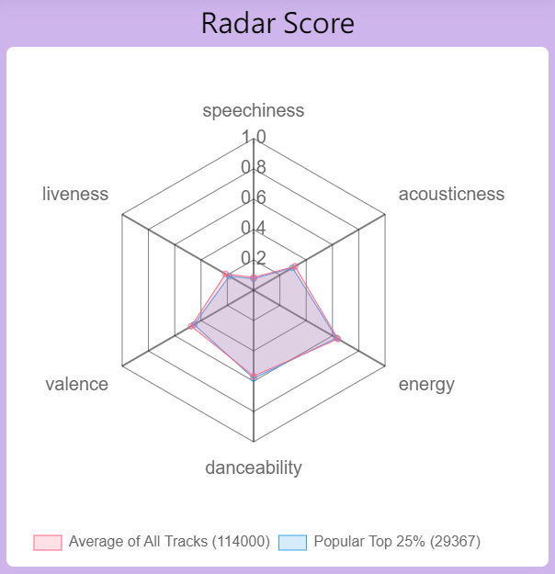
How to Use It…
Speechiness: Presence of spoken words in a track
Acousticness: Confidence of whether the track is acoustic
Energy: Perceptual measure of intensity and activity
Danceability: How suitable a track is for dancing
Valence: Musical positiveness conveyed by a track
Liveness: Presence of an audience in the recording
The purple graph shows the radar chart of the scores between each collection.

Slide 7
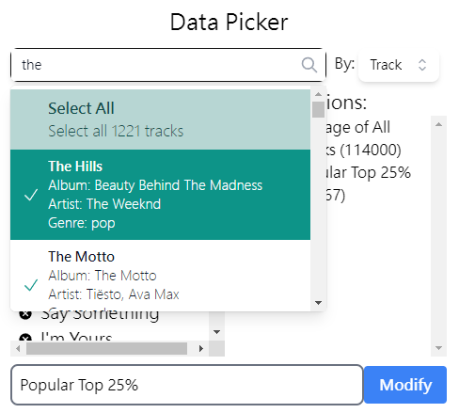
Some Details on Data Picker…
Implemented fuzzy search, “auto completes”
for the user even if there are some typos.
User can select all the tracks once, or tick the tracks one by one.
The data inside scroll bars are virtualized, which only renders as you scroll to it. (Instead of spending few seconds rendering everything)
This massively improves performance, giving good user experience.

Slide 8
Story in the Dataset: Use Cases
There are many use cases for this tool.
I will demo 2 use cases, and show only the key steps and graphs.

Slide 9
Use Case #1: Specific Genre Analysis
Compare between popular genres

Slide 10
Specific Genre Analysis (1)
1. Inspecting popular top 25% tracks,
we find out genre: “pop-film” has
the largest portion.
I would like to take a look at
what’s special for this genre,
compared to the average.

Slide 11
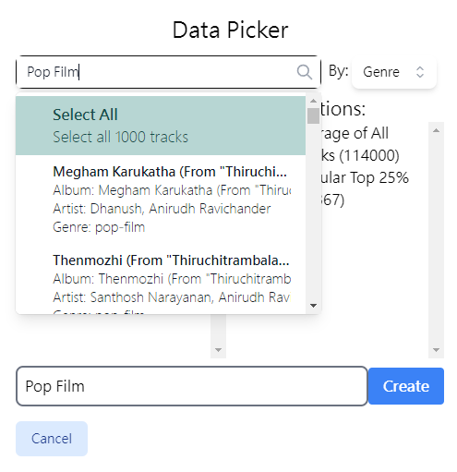
Specific Genre Analysis (2)
2. Search “pop-film” by genre in data picker,
and create a new collection called “Pop Film”.

Slide 12
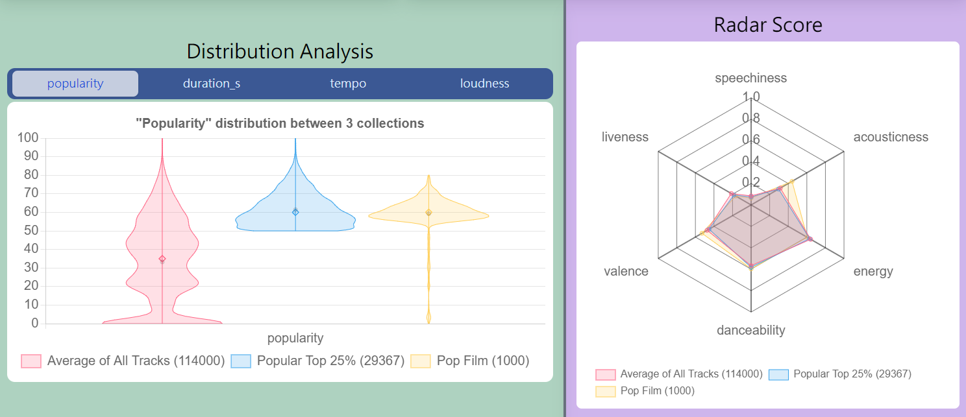
Specific Genre Analysis (3)
3. We can see acousticness and valence of pop film tracks are much higher,
and most of the tracks have much higher popularity than average.

Slide 13
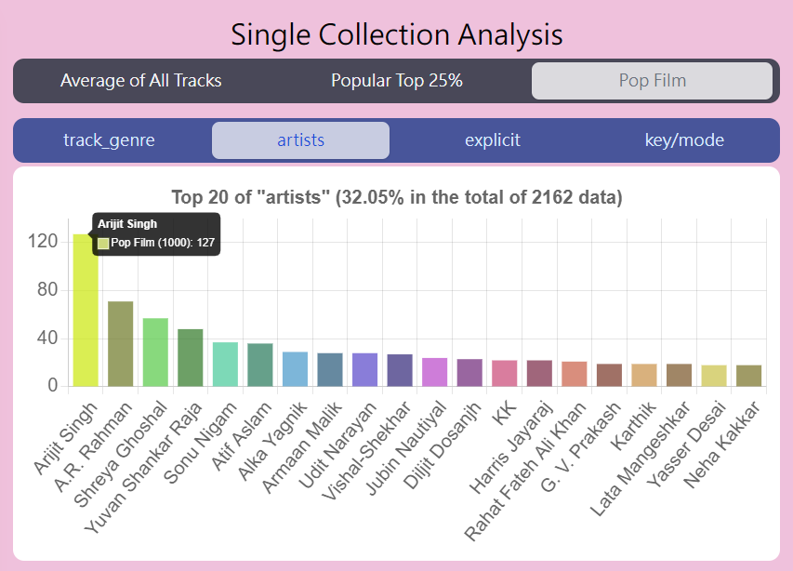
Specific Genre Analysis (4)
4. By checking Single collection Analysis,
We can see the artists contributing
the most pop-film tracks.

Slide 14
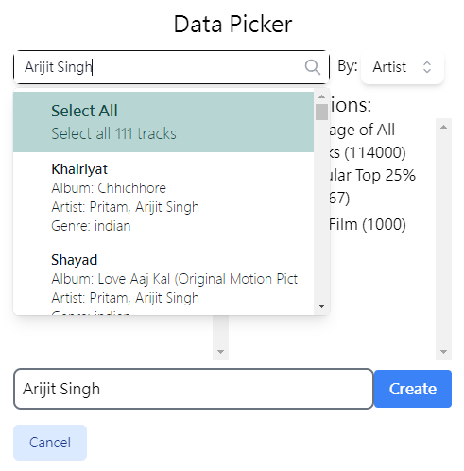
Specific Genre Analysis (drill down)
Assume I am curious about pop-film top1
“Arijit Singh”, I can again create a collection of his:

Slide 15
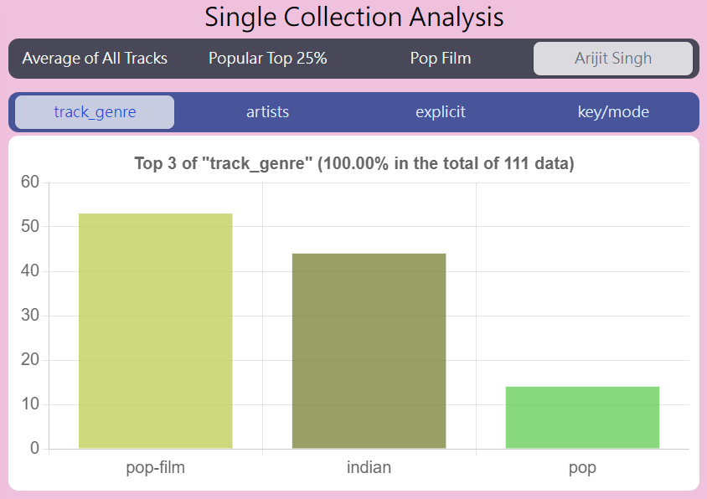
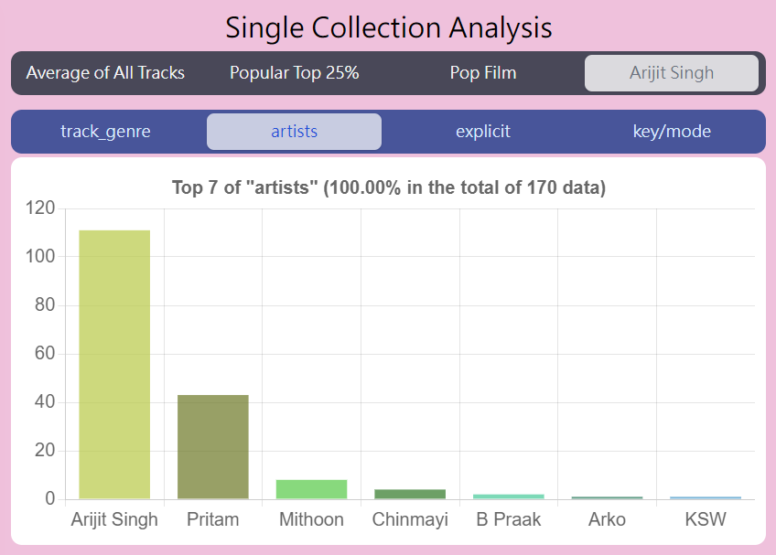
Specific Genre Analysis (drill down)
Arijit Singh also does other genres!
... and his collaborations with other artists

Slide 16
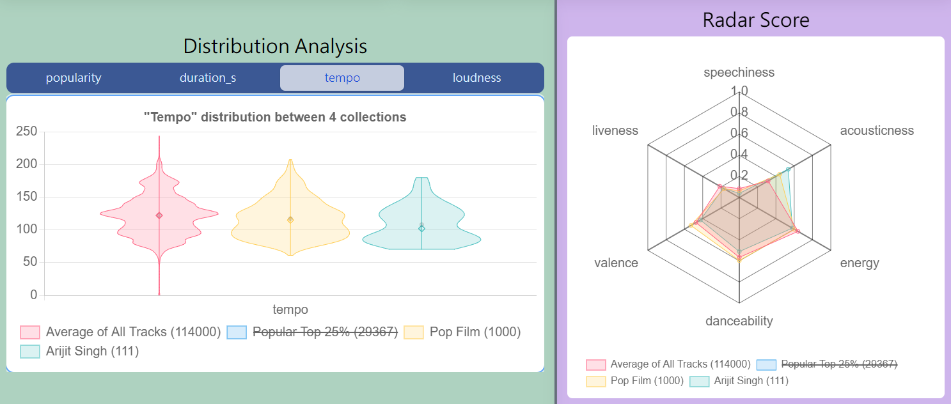
Specific Genre Analysis (drill down)
Arijit Singh tends to have lower tempo and valence, with way higher acousticness.

Slide 17
Use Case #2: Artist’s Album Analysis
Compare between an Artist’s Album

Slide 18
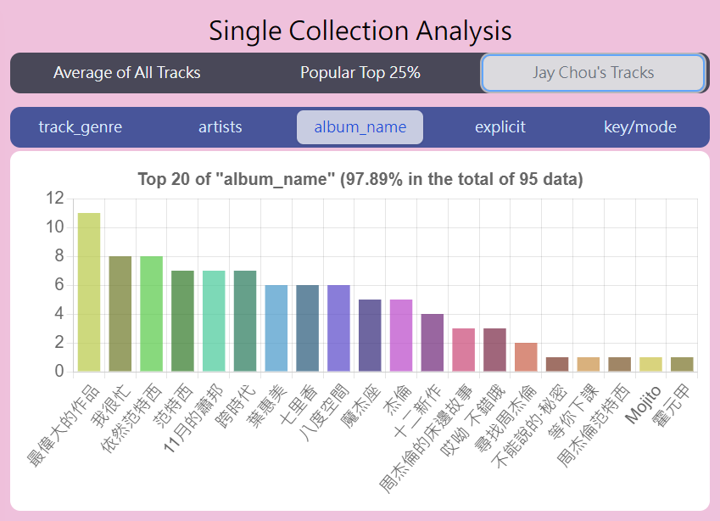
Artist’s Album Analysis (1)
1. First analyze all Jay Chou’s albumns.
We can see that the newest album,
“最偉大的作品” records the most tracks.
Let’s compare it with
another popular album, “七里香”

Slide 19
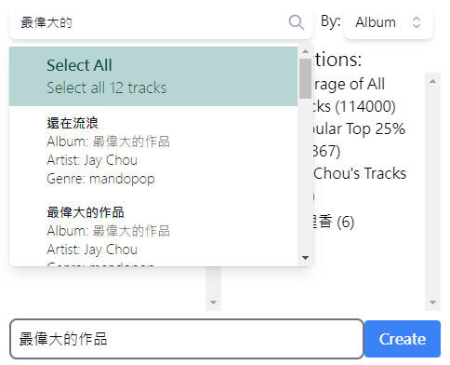
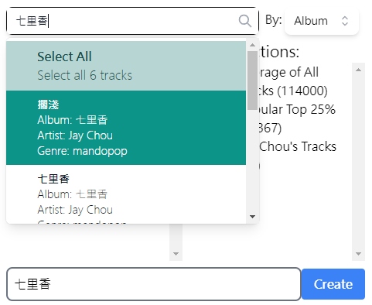
Artist’s Album Analysis (2)
1. Add 2 collections reffering to the two albums: “最偉大的作品”, “七里香”

Slide 20
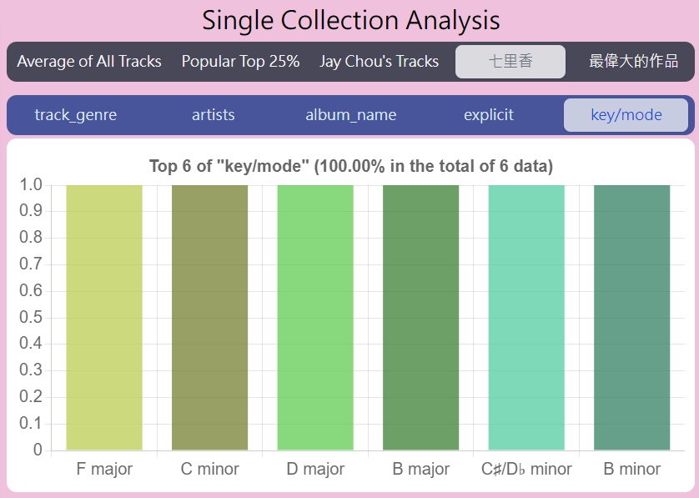
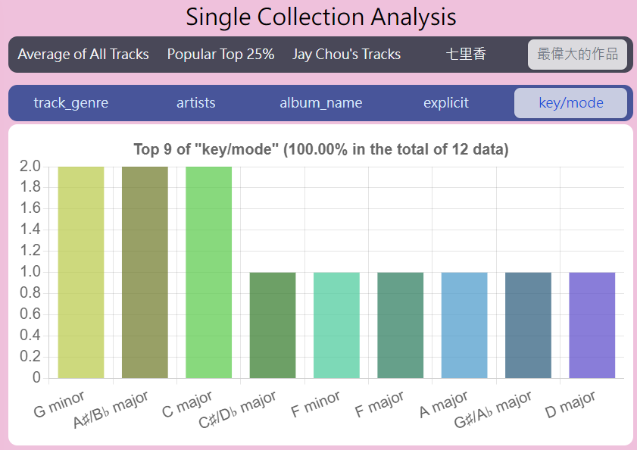
Artist’s Album Analysis (results)
“七里香”, “最偉大的作品” almost all uses different keys on each track.
This shows Jay Chou have additional thoughts in arranging songs for his albums.

Slide 21
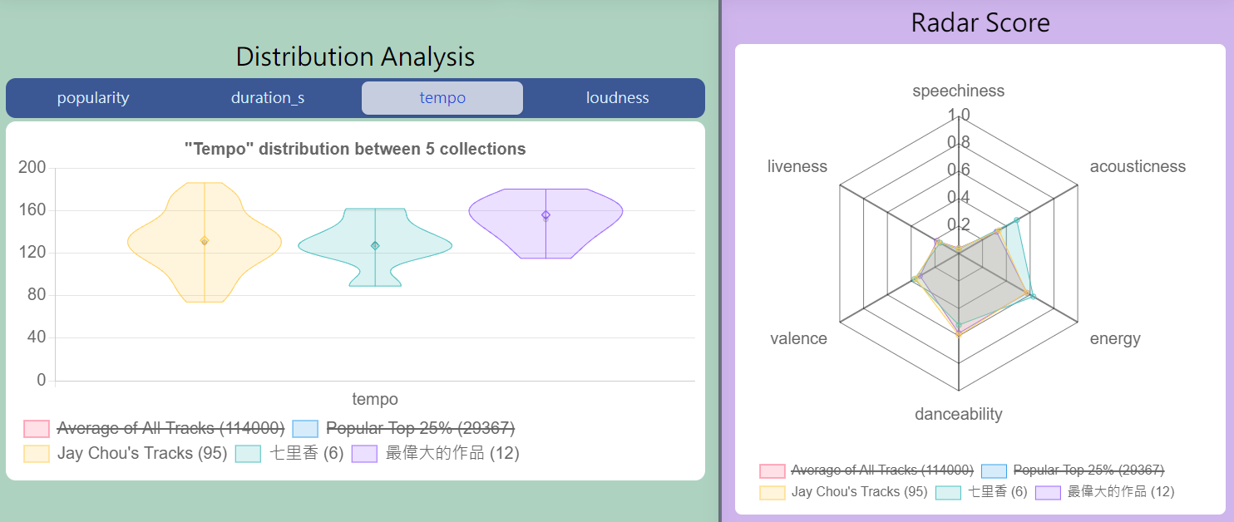
Artist’s Album Analysis (results)
Tracks in “最偉大的作品” have higher tempo, and “七里香” have higher acousticness,
compared with the average of his tracks.

